Slide 1

M.TECH MAJOR PROJECT REVIEW II (MVE33)
A SLAM BASED AUGMENTED REALITY (AR) DESIGN
Under the guidance of : Dr. Reshma Verma (Asst. Professor)
Name: Nehru H
USN: 1MS20LVS08
Specialization: VLSI Design and Embedded Systems
Date: 01-Feb-2022

Slide 2

INTRODUCTION
SLAM (Simultaneous Localization and mapping): It is the process of mapping an area whilst keeping track of the location of the device within that area. This is what makes mobile mapping possible. This allows map construction of large areas in much shorter spaces of time as areas can be measured using mobile robots, drones or vehicles. SLAM systems simplify data collection and can be used in outdoor or indoor environments.

Slide 3
CURRENT STATE OF THE ART
The global SLAM Technology market report provides geographic analysis covering regions, such as North America, Europe, Asia-Pacific, and Rest of the World. The SLAM Technology market for each region is further segmented for major countries including the U.S., Canada, Germany, the U.K., France, Italy, China, India, Japan, Brazil, South Africa, and others.
The global SLAM Technology market is segregated on the basis of Type as EKF SLAM, Fast SLAM, Graph-Based SLAM, and Others. Based on Application the global SLAM Technology market is segmented in Robotics, UAV, AR/VR, Automotive, and Others.

Slide 4

PROBLEM STATEMENT
Simultaneous localization and mapping, or SLAM for short, is the process of creating a map using a robot or unmanned vehicle that navigates that environment while using the map it generates. SLAM is technique behind robot mapping.
S.L.A.M. is in it’s infancy right now. The biggest issue/challenge with S.L.A.M. is what’s described as a “chicken-and-the-egg”. Meaning, to accurately map an environment, the technology must know the orientation and position within the map. However, the orientation and position information can only be taken from a pre-existing map of the environment. This issue makes S.L.A.M. difficult.
Another challenge that S.L.A.M. technology poses is that of accuracy. The technology is largely dependent upon accurate measurements and mathematics. For the machine that is running the technology to understand and create the map, the device’s sensors collect visual data from the real-world and marks them as reference points.

Slide 5
LITERATURE REVIEW
S.NO | RESEARCH PAPER | NOVELTY | SUMMARY
[1] | Gijs Dubbelman and Brett Browning, “COP-SLAM: Closed-Form Online Pose-Chain Optimization for Visual SLAM”, IEEE TRANSACTIONS ON ROBOTICS, VOL. 31, NO. 5, OCTOBER 2015. | Closed-Form Solution: The concept behind the closed form solution to trajectory bending is to optimally transfer the error at the loop-closing edge over all successive edges. | It is a theoretically unique SLAM approach that is specifically designed to optimize pose-chains, which are extremely sparse locally accurate pose-graphs that result from applying state-of-the-art visual-SLAM front-ends in large-scale environments for which frequent loop detection is not desired or not possible.
[2] | Renato F. Salas-Moreno, Richard A. Newcombe, Hauke Strasdat, Paul H. J. Kelly and Andrew J. Davison, “SLAM++: Simultaneous Localisation and Mapping at the Level of Objects”, 2013 IEEE Conference on Computer Vision and Pattern Recognition. | They follow the approach of recognizing the 6DoF pose of 3D objects, represented by meshes, in a depth image. | In this paper the authors have shown that using high performance 3D object recognition in the loop permits a new approach to real-time SLAM with large advantages in terms of efficient and semantic scene description. In particular they demonstrate how the tight interaction of recognition, mapping and tracking elements is mutually beneficial to all.
[3] | Xin Yang, Zikang Yuan, Dongfu Zhu, Cheng Chi, Kun Li and Chunyuan Liao, ”Robust and Efficient RGB-D SLAM in Dynamic Environments”, TMM.2020.3038323, IEEE Transactions on Multimedia. | ORB-SLAM2 is a real-time SLAM for Monocular, Stereo and RGB-D cameras that computes the camera trajectory and a sparse 3D reconstruction (in the stereo and RGB-D case with true scale). It is able to detect loops and re-localize the camera in real time. | In this paper the authors propose an efficient RGB-D SLAM built on top of ORB-SLAM2 for dynamicscenarios. The authors observe that by carefully designing the dynamic region identification algorithm, it is not necessary to employ sophisticated semantic segmentation methods for region partition as most existing systems did.

Slide 6
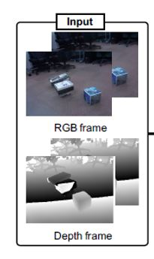
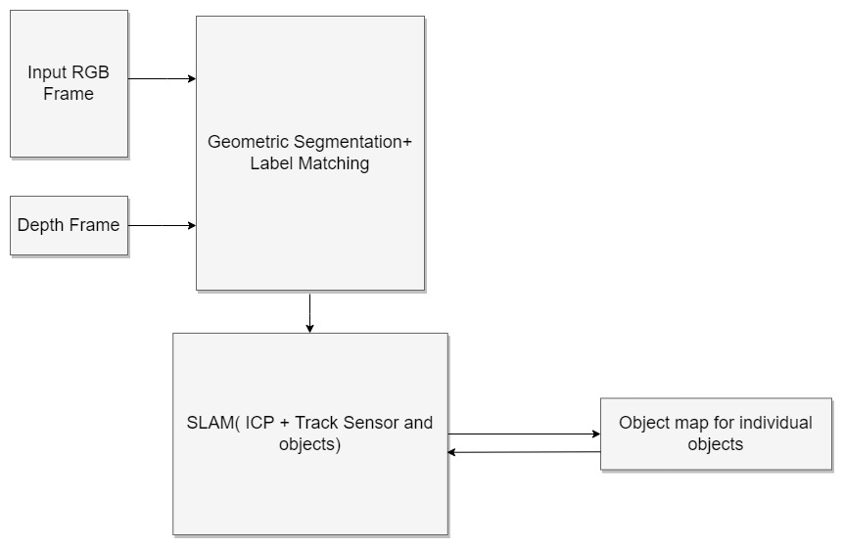
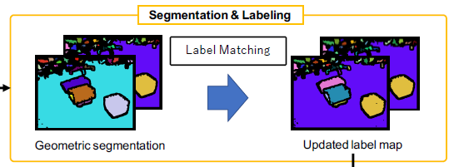
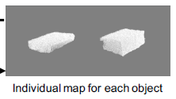
BLOCK DIAGRAM

Slide 7
METHODOLOGY & PROGRESS
Histogram Equalization:
Histogram Equalization is a computer image processing technique used to improve contrast in images. It accomplishes this by effectively spreading out the most frequent intensity values, i.e. stretching out the intensity range of the image. This method usually increases the global contrast of images when its usable data is represented by close contrast values. This allows for areas of lower local contrast to gain a higher contrast.

Slide 8
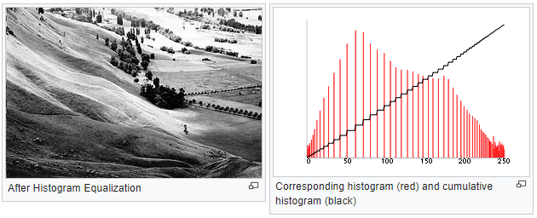
A color histogram of an image represents the number of pixels in each type of color component. Histogram equalization cannot be applied separately to the Red, Green and Blue components of the image as it leads to dramatic changes in the image’s color balance. However, if the image is first converted to another color space, like HSL/HSV color space, then the algorithm can be applied to the luminance or value channel without resulting in changes to the hue and saturation of the image.

Slide 9
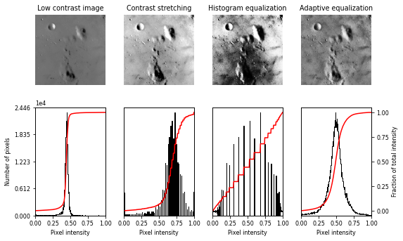
OBTAINED EQUALIZATION OUTPUTS FOR IMAGE INPUTS:

Slide 10
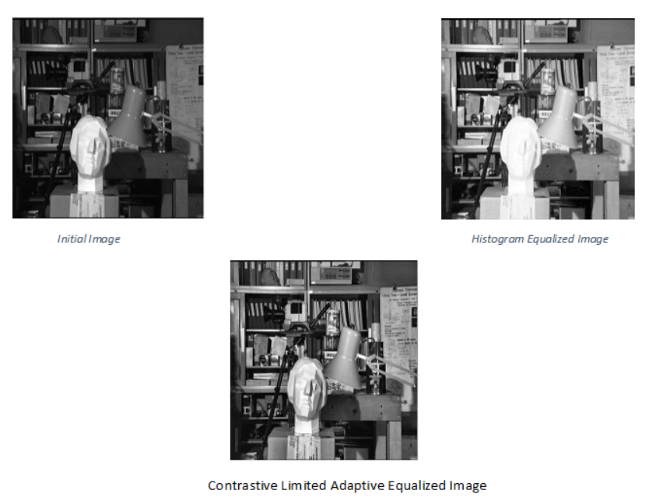
Contrastive Limited Adaptive Equalization:
Contrast Limited AHE (CLAHE) differs from adaptive histogram equalization in its contrast limiting. In the case of CLAHE, the contrast limiting procedure is applied to each neighborhood from which a transformation function is derived. CLAHE was developed to prevent the over amplification of noise that adaptive histogram equalization can give rise to.

Slide 11
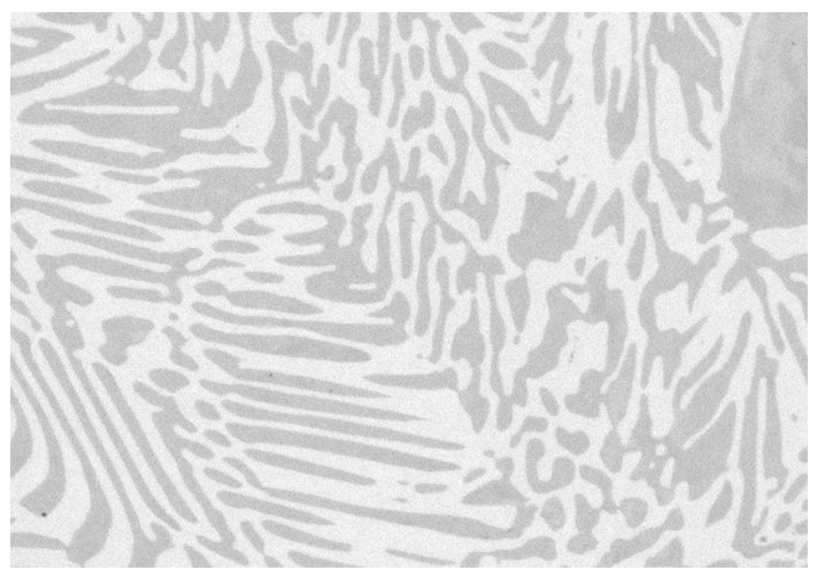
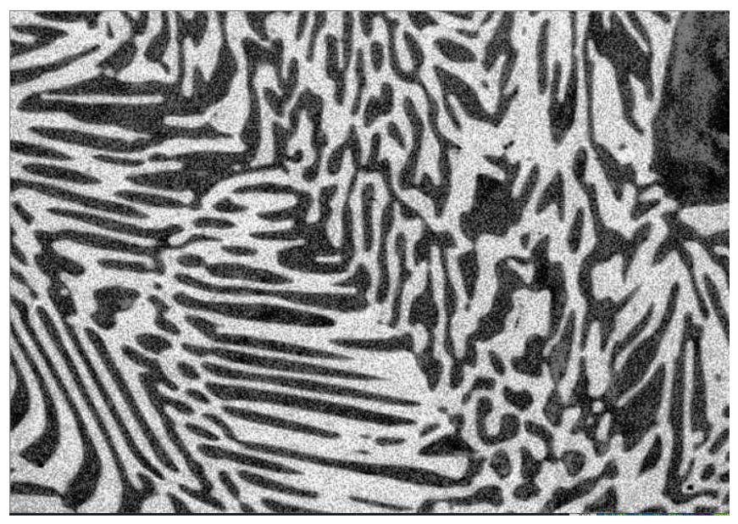
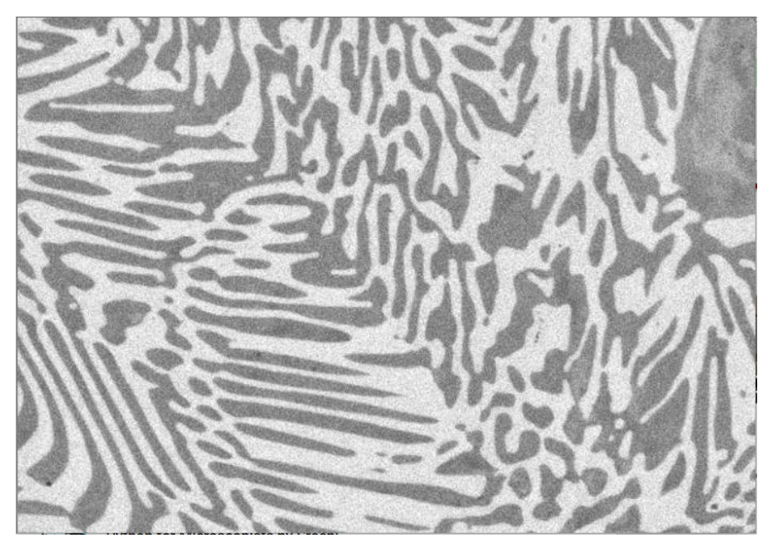
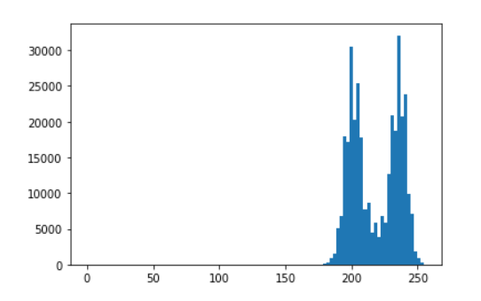
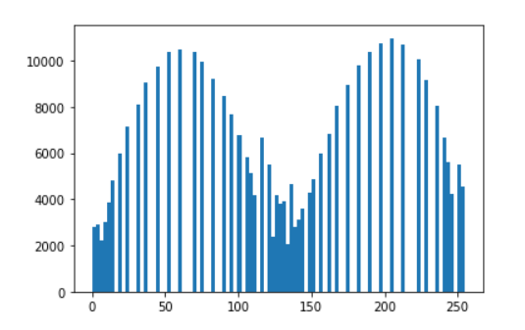
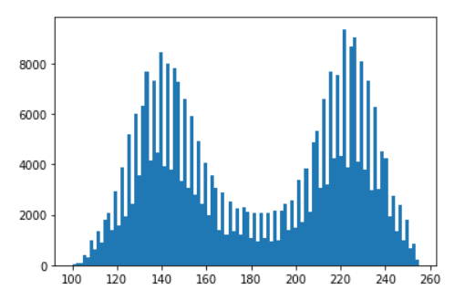
PRE-PROCESSING OUTPUTS FOR HISTOGRAM EQUALIZATIONS
Fig 1: RAW image with histogram Fig 2: HE image with histogram Fig 3: CLAHE image with histogram

Slide 12
In above, we introduce a dark image enhancement based on Contrast Limited Adaptive Histogram
The RGB image is converted into HSV color space, from that image intensity component is extracted and it is normalized.
Intensity component contain extremely dark pixels and when intensity value is enhanced, pixel noises will be introduced.
So we take the inverse of the intensity component before removing the noise.
The Contrast Limited Adaptive Histogram Equalization (CLAHE) is applied to the inverse of the intensity component, thus it enhances the image.
This method can be efficient for real time extremely dark image enhancement applications.

Slide 13
ITERATIVE CLOSEST POINT ALGORITHM
Iterative closest point (ICP) is an algorithm employed to minimize the difference between two clouds of points. ICP is often used to reconstruct 2D or 3D surfaces from different scans, to localize robots and achieve optimal path planning.
Variants on the following stages of ICP have been proposed:
1. Point subsets (from one or both point sets).
2. Weighting the correspondences.
3. Data association.
4. Rejecting certain (outlier) point pairs.

Slide 14
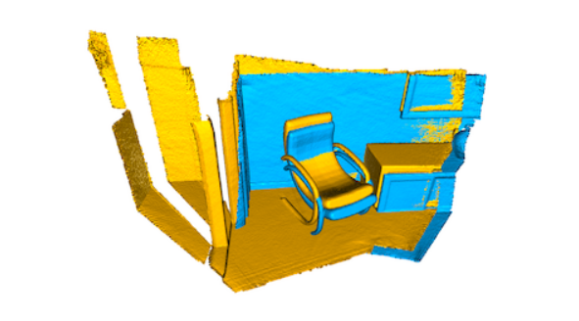
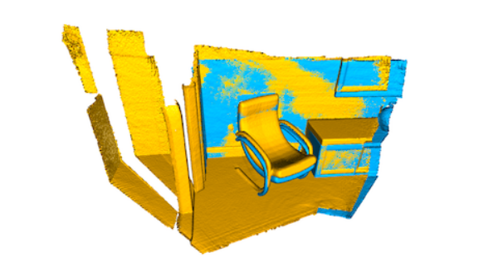
ICP RESULTS OBTAINED
Fig 4: Input image (source points-yellow, and Target points-cyan) Fig 5: point to point ICP output after 30 iterations

Slide 15
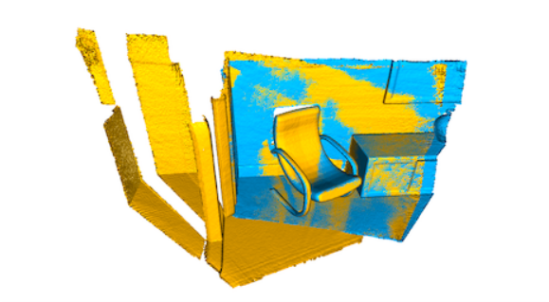
Fig 6: after ICP output 30 iterations Fig 7: point to point ICP output after 144 iterations
In general, the ICP algorithm iterates over two steps:
Find correspondence set K={(p,q)} from target point cloud P, and source point cloud Q transformed with current transformation matrix T.
Update the transformation T by minimizing an objective function E(T) defined over the correspondence set K.

Slide 16

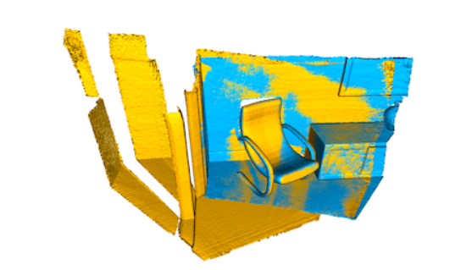
ICP (POINT TO PLANE)
Fig 8: Input image (source points-yellow, and Target points-cyan) Fig 9: point to plane ICP output after 30 iterations
The point-to-plane ICP algorithm uses a different objective function:
E(T)=∑(p,q)∈K((p−Tq)⋅np)2,
where np is the normal of point ‘p’. The point-to-plane ICP algorithm has a faster convergence speed than the point-to-point ICP algorithm.

Slide 17
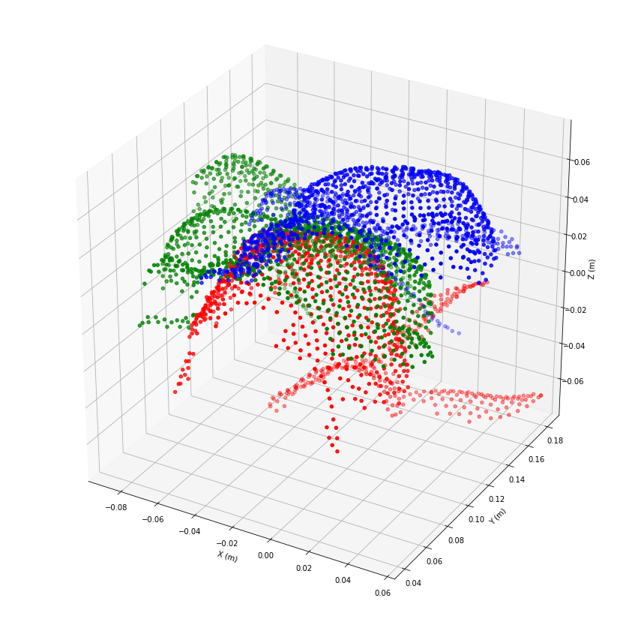
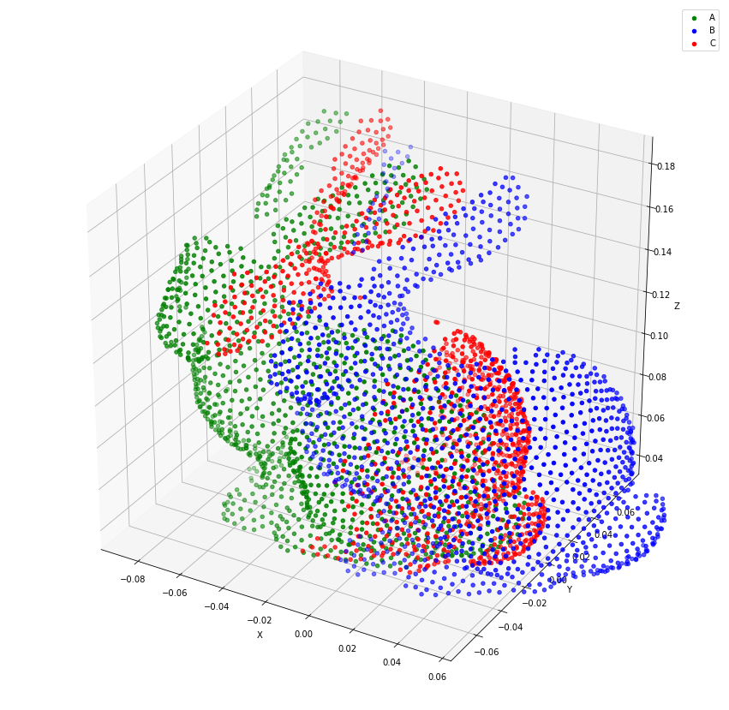
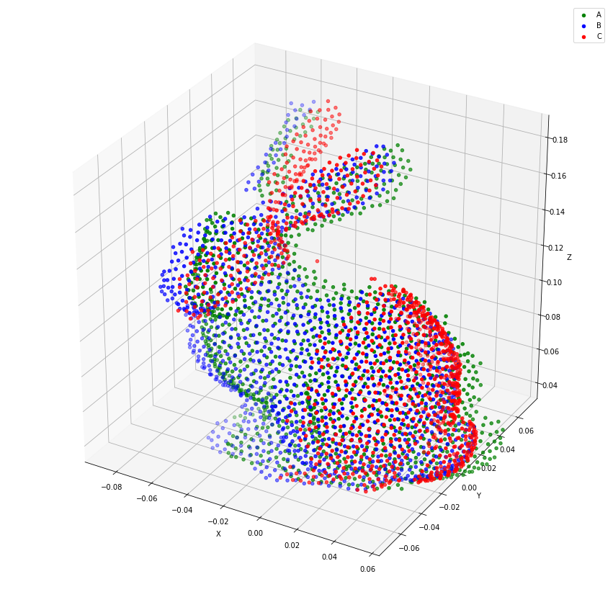
ICP FOR 3D IMAGES
Fig 10 Fig 11 Fig 12
Fig 10 shows the input point clouds, Fig 11 shows the updated axis and Fig 12 shows final projected output for point to point ICP.

Slide 18
TIMELINE
S NO | PROCESSES TO BE COMPLETED |  | DEADLINE
1. | Pre-Processing | Geometric Image Segmentation (1 Week) | 15-January-2022
 |  | Label Matching (3 Weeks)
2. | SLAM: | ICP (1 Week) | 15-February-2022
 |  | Track Sensor and Objects (2 Weeks)
 |  | Fuse models (1 Week)

Slide 19
PLAN FOR NEXT SEMESTER
Improvising SLAM Algorithm process.
Process the proposed design in various 3D datasets (Google AI/meta AR/ NYU model etc).
Verifying the proposed design with customized dataset.
Improving acceleration of training on GPU/CPU.
Verifying the 3D mapping with multiple moving objects on scene with moving sensor and analyzing the results.
Comparison of proposed design with similar SLAM Designs.

Slide 20
REFERENCES
[1] Gijs Dubbelman and Brett Browning, “COP-SLAM: Closed-Form Online Pose-Chain Optimization for Visual SLAM”, IEEE TRANSACTIONS ON ROBOTICS, VOL. 31, NO. 5, OCTOBER 2015.
[2] Renato F. Salas-Moreno, Richard A. Newcombe, Hauke Strasdat, Paul H. J. Kelly and Andrew J. Davison, “SLAM++: Simultaneous Localisation and Mapping at the Level of Objects”, 2013 IEEE Conference on Computer Vision and Pattern Recognition.
[3] Xin Yang, Zikang Yuan, Dongfu Zhu, Cheng Chi, Kun Li and Chunyuan Liao, ”Robust and Efficient RGB-D SLAM in Dynamic Environments”, TMM.2020.3038323, IEEE Transactions on Multimedia.
https://www.pyimagesearch.com/2021/02/01/opencv-histogram-equalization-and-adaptive-histogram-equalization-clahe/
https://scikitimage.org/docs/dev/auto_examples/features_detection/plot_blob.html#sphx-glr-download-auto-examples-features-detection-plot-blob-py
https://ai.facebook.com/blog/recognizing-3d-spaces-without-spatial-labels/
https://ai.googleblog.com/2021/02/3d-scene-understanding-with-tensorflow.html

Slide 21
THANK YOU

